Slide 1

Netflix Content Trends Analysis
Tejas V
APPLY_175656163568b300e3a9e5d

Slide 2

PROBLEM STATEMENT
Netflix has become one of the most prominent global streaming platforms, continuously expanding its library with a mix of original productions and licensed content. However, with growing competition from platforms like Amazon Prime, Disney+, and regional OTT providers, Netflix must strategically analyze its content catalog to identify strengths, gaps, and opportunities.
The specific problem to be addressed in this project is 'Content Trends Analysis for Strategic Recommendations'. The aim is to uncover how Netflix’s content distribution (Movies vs. TV Shows, genres, and country contributions) has evolved over the years. This will enable the identification of key genres, audience preferences, and strategic insights into global content expansion.

Slide 3
Project Description
Analyze the distribution and growth of Movies and TV Shows on Netflix over the years.
Identify the most frequent genres and observe changes in their popularity.
Compare country-wise contributions to Netflix’s content base to assess global diversity.
Provide strategic recommendations for future content acquisition and production.
Significance of the Study
This analysis is significant for understanding Netflix’s content evolution and audience engagement patterns. By identifying popular genres and underrepresented regions, the study offers actionable insights that can help Netflix make data-driven business decisions. Such findings are valuable for:
Enhancing content strategy and balancing global vs. local productions.
Recognizing market trends and regional viewer interests.
Supporting strategic investments in specific content types and countries.

Slide 4

WHO ARE THE END USERS?
Internal Users (Primary Business Users)
Content Strategists: Decide which genres, languages, and formats to invest in.
Marketing Teams: Identify target regions and plan campaigns based on trends.
Data Analysts / Decision Makers: Evaluate content growth and performance metrics.
Product Managers: Understand user engagement patterns to improve features.
External Users (Indirect Beneficiaries)
Investors / Stakeholders: Monitor content library growth, trends, and audience preferences.
Subscribers / Customers: Receive better-curated content based on analysis and trends.
Partners / Production Studios: Understand what type of content Netflix prefers for co-productions.

Slide 5

Technology Used
Programming Languages & Libraries
Python: Main programming language for data analysis.
Pandas: Data cleaning, manipulation, and processing.
NumPy: Numerical operations and array handling.
Matplotlib & Seaborn: Data visualization (bar charts, line charts, heatmaps, histograms).
Collections (Counter): Counting genres, countries, and other categorical data.
Datetime: Handling and parsing dates for trend analysis.
Development / Execution Environment
Google Colab: Cloud-based notebook environment for coding, visualization, and easy file uploads/downloads.

Slide 6
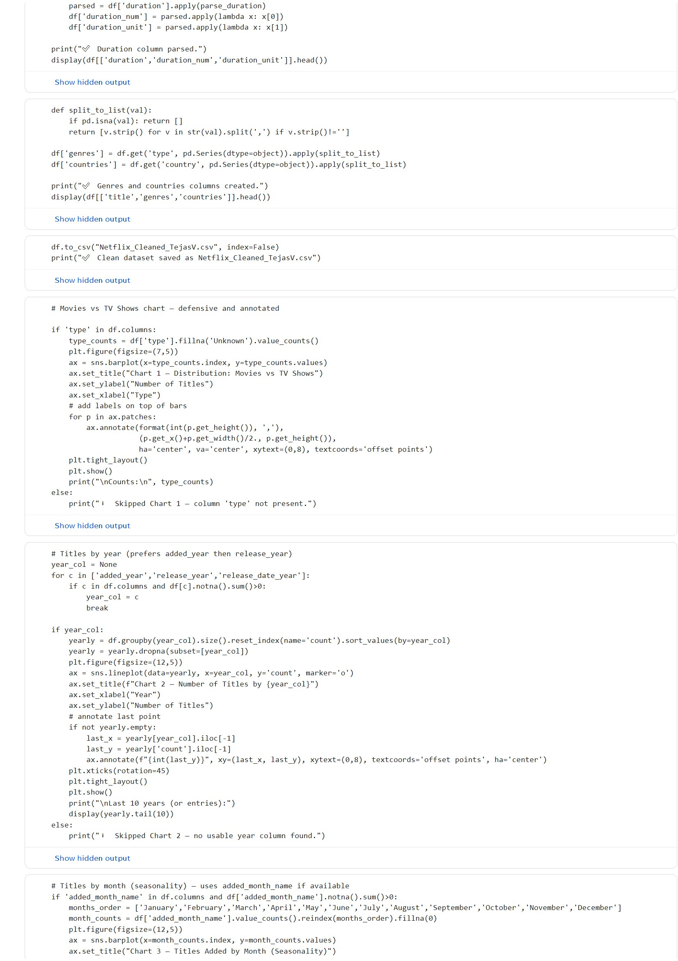
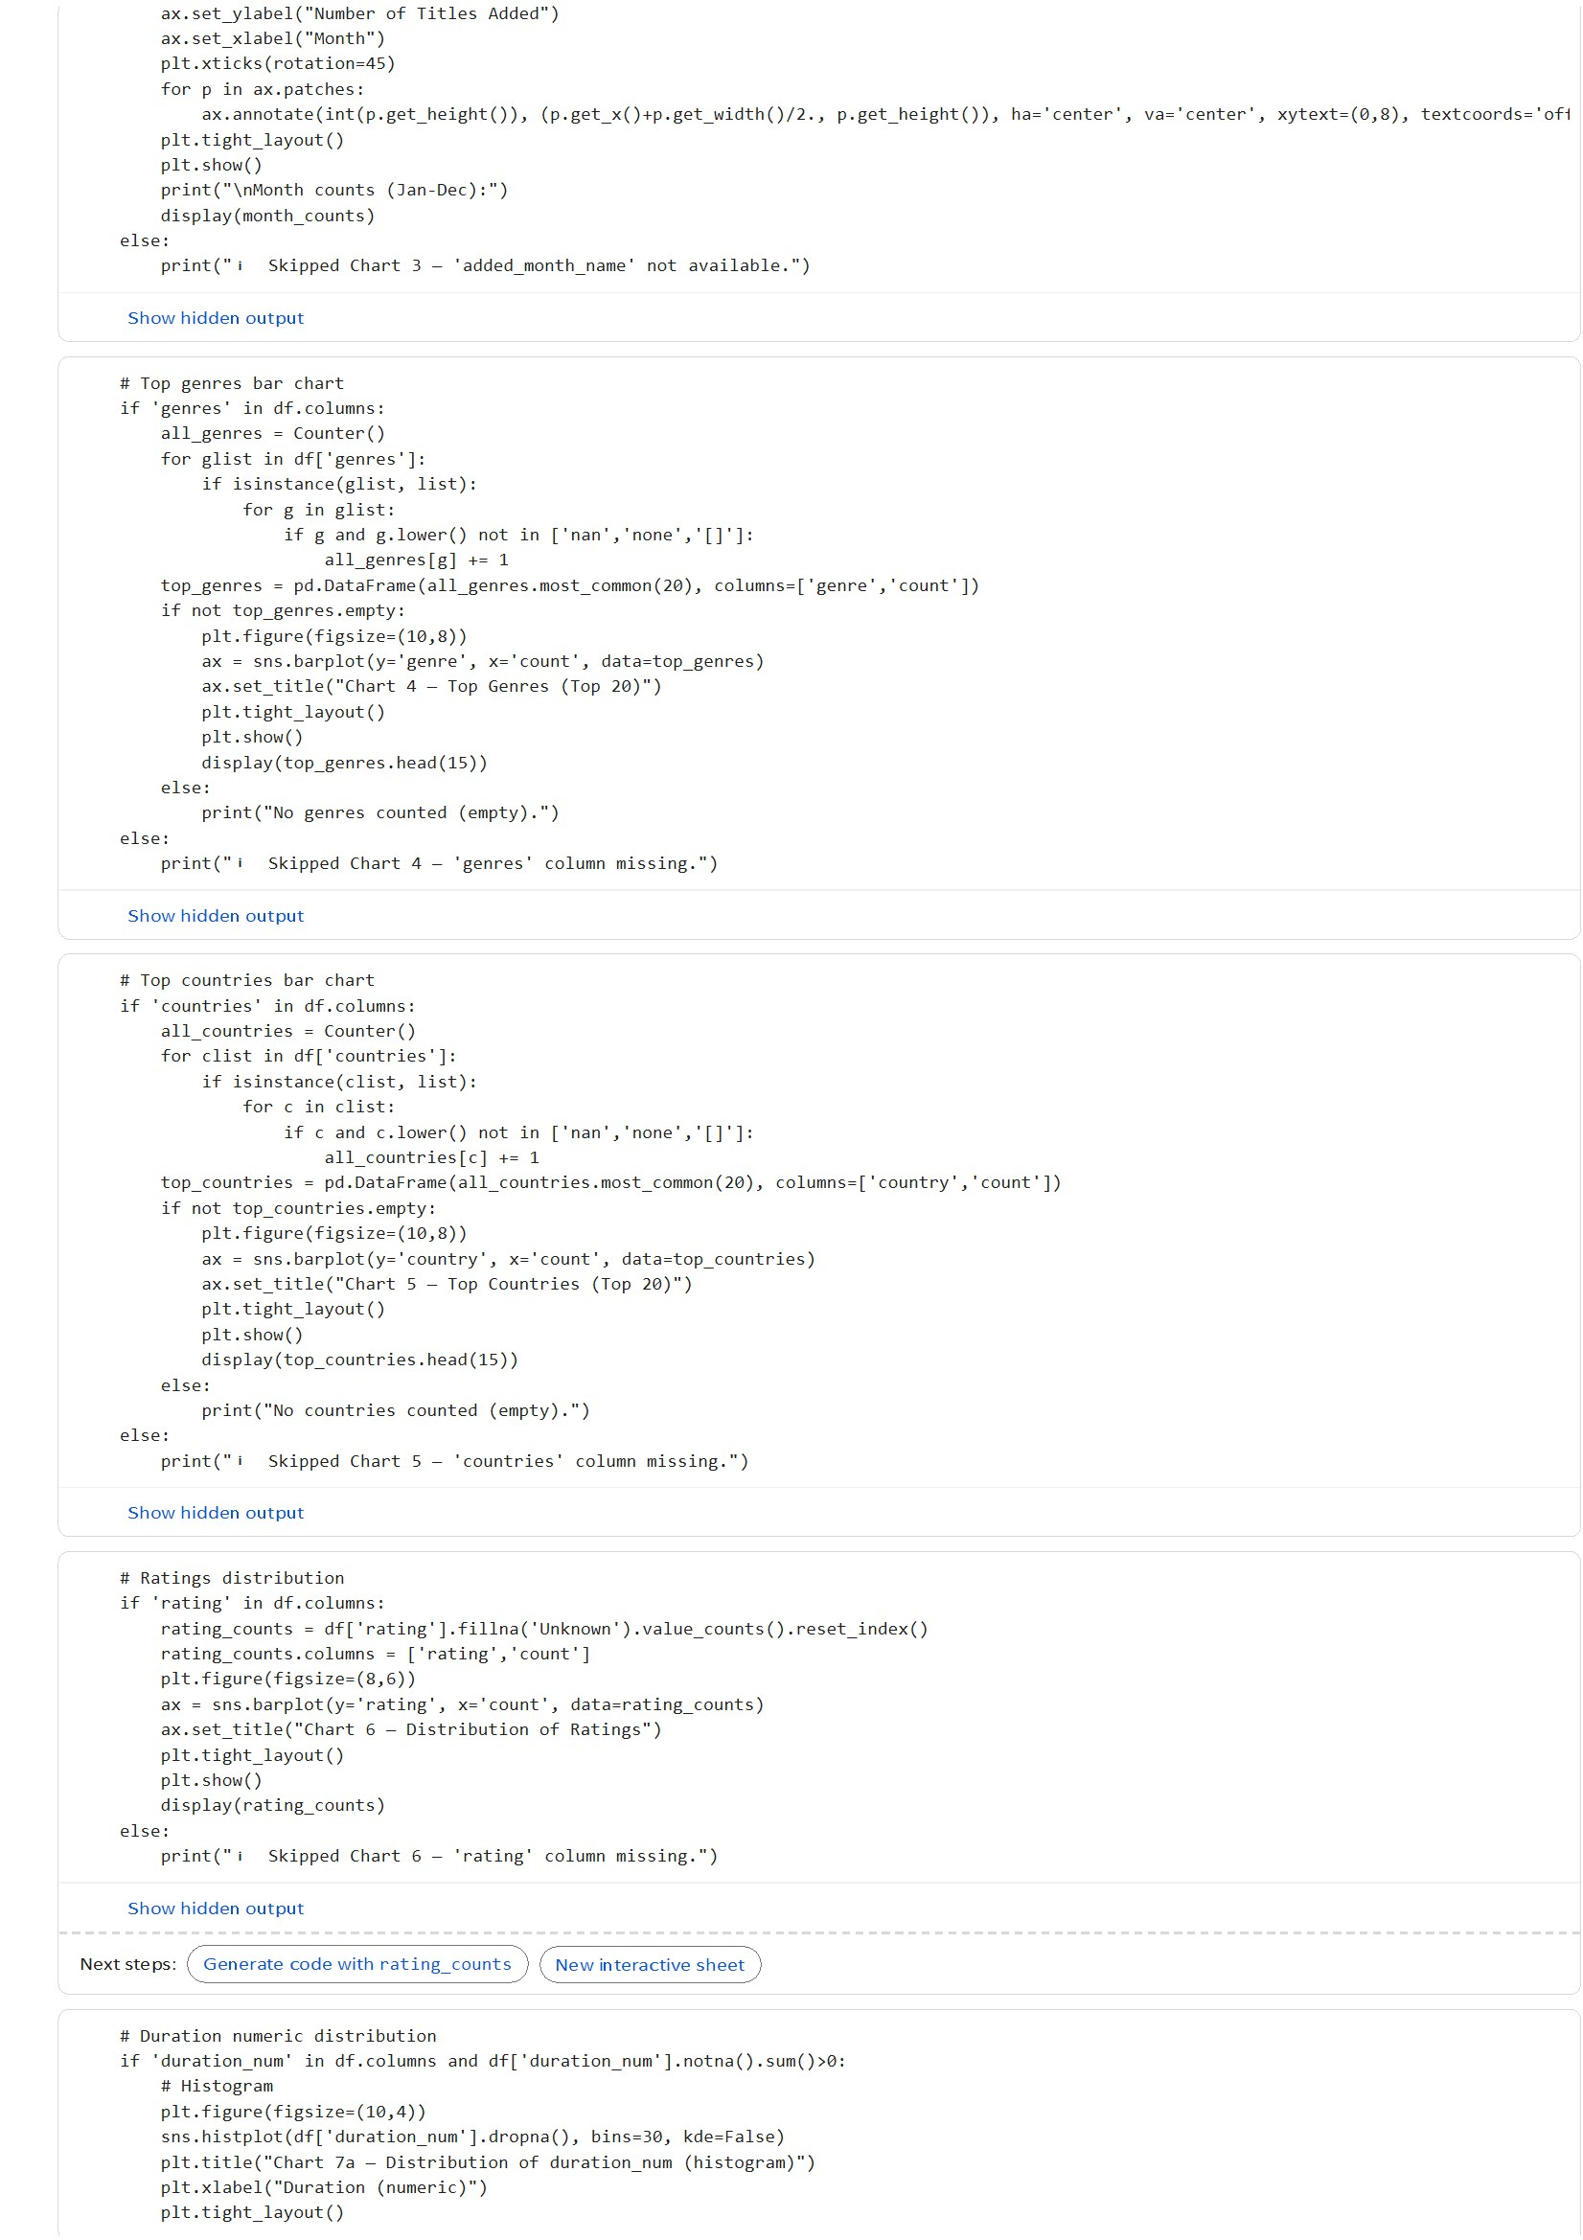
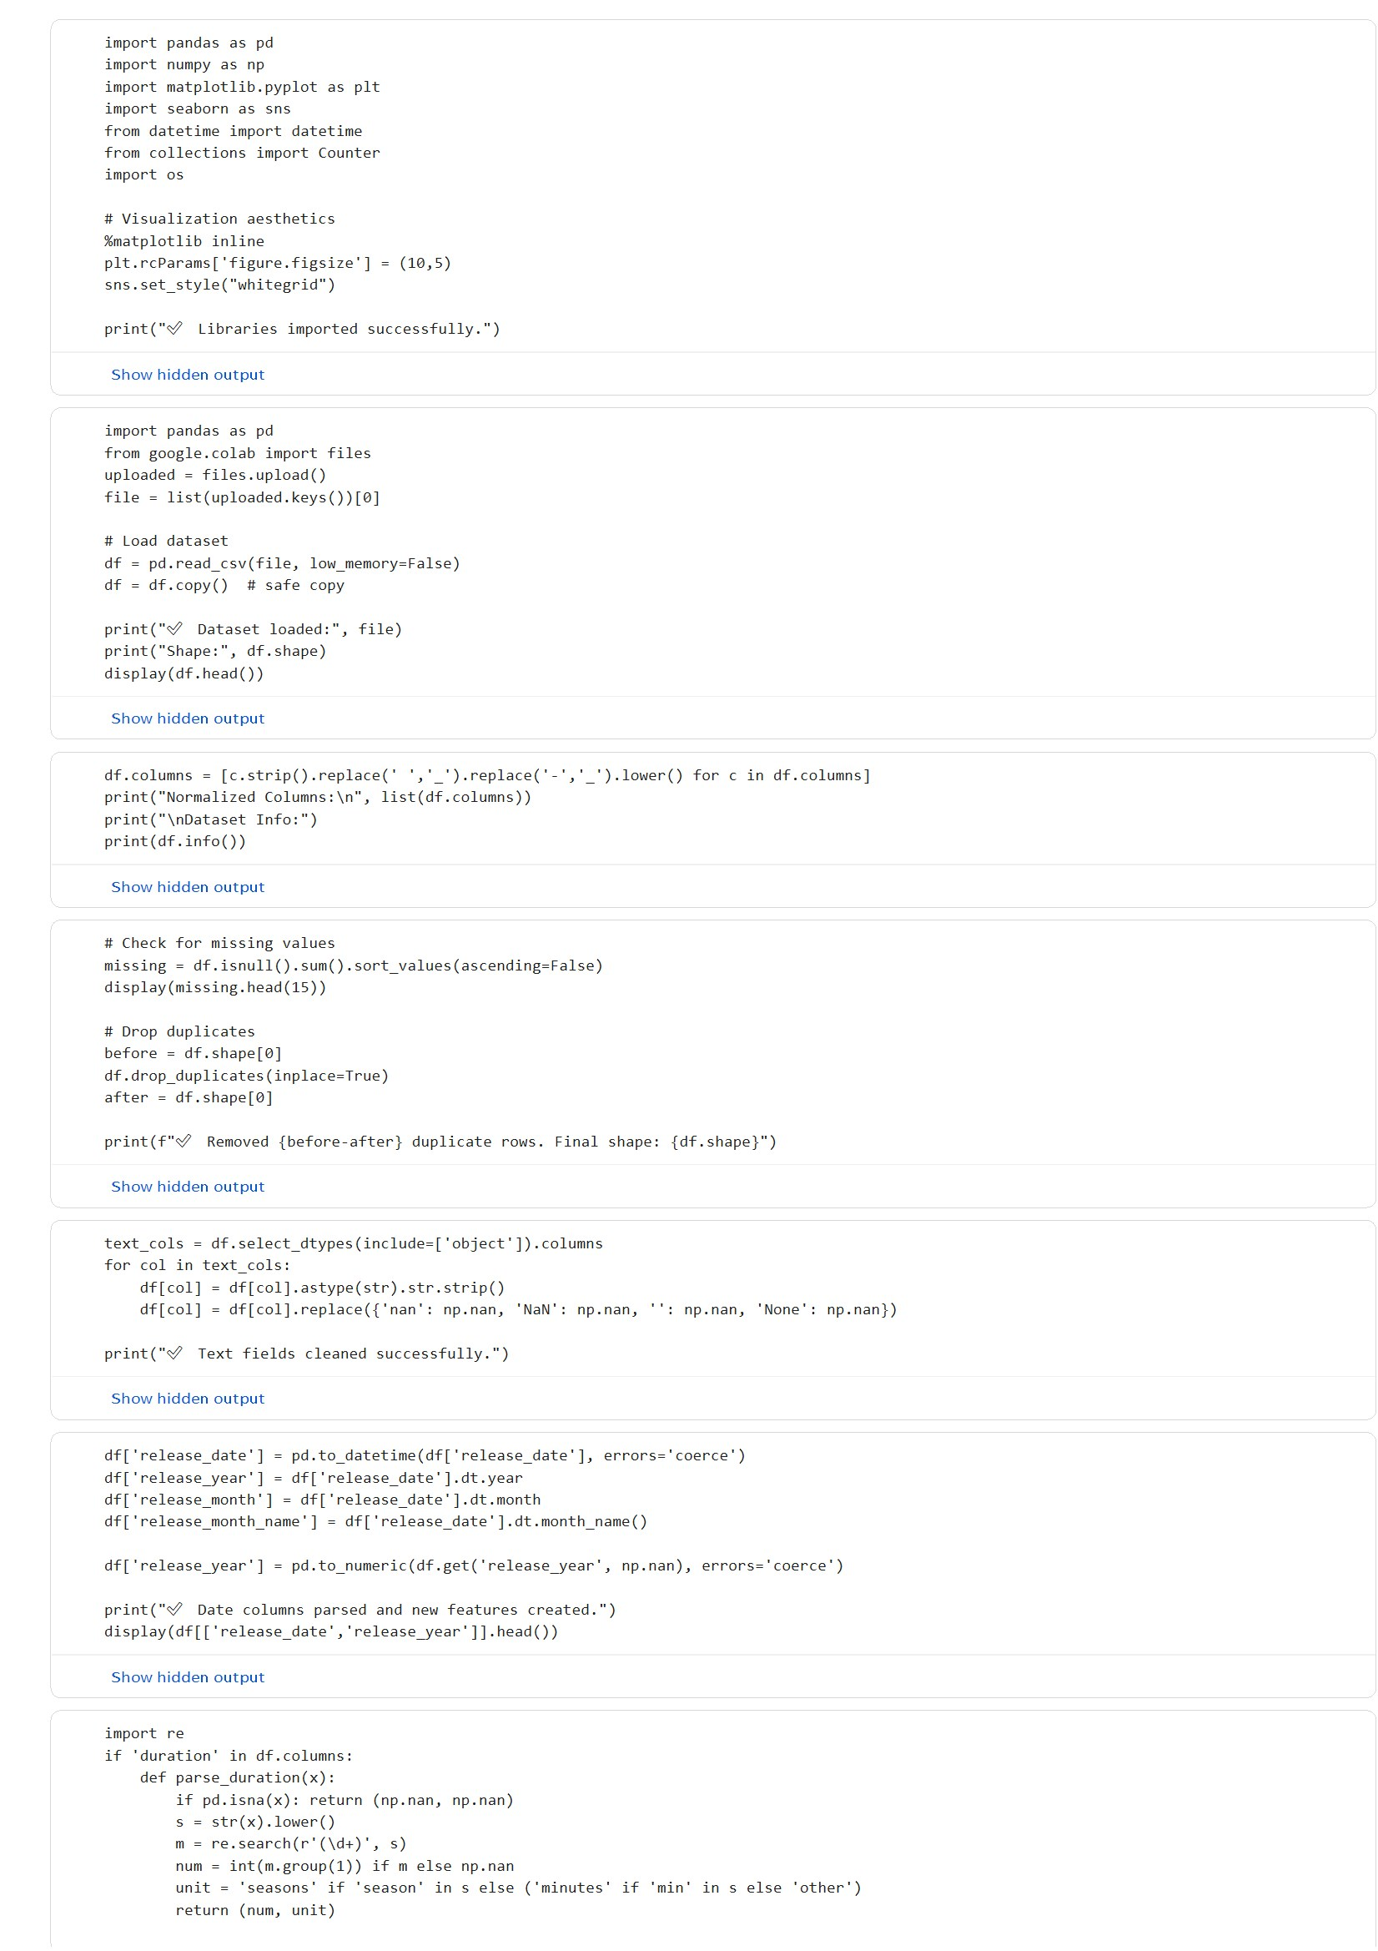
RESULTS1
Paste the screen shot of your code

Slide 7
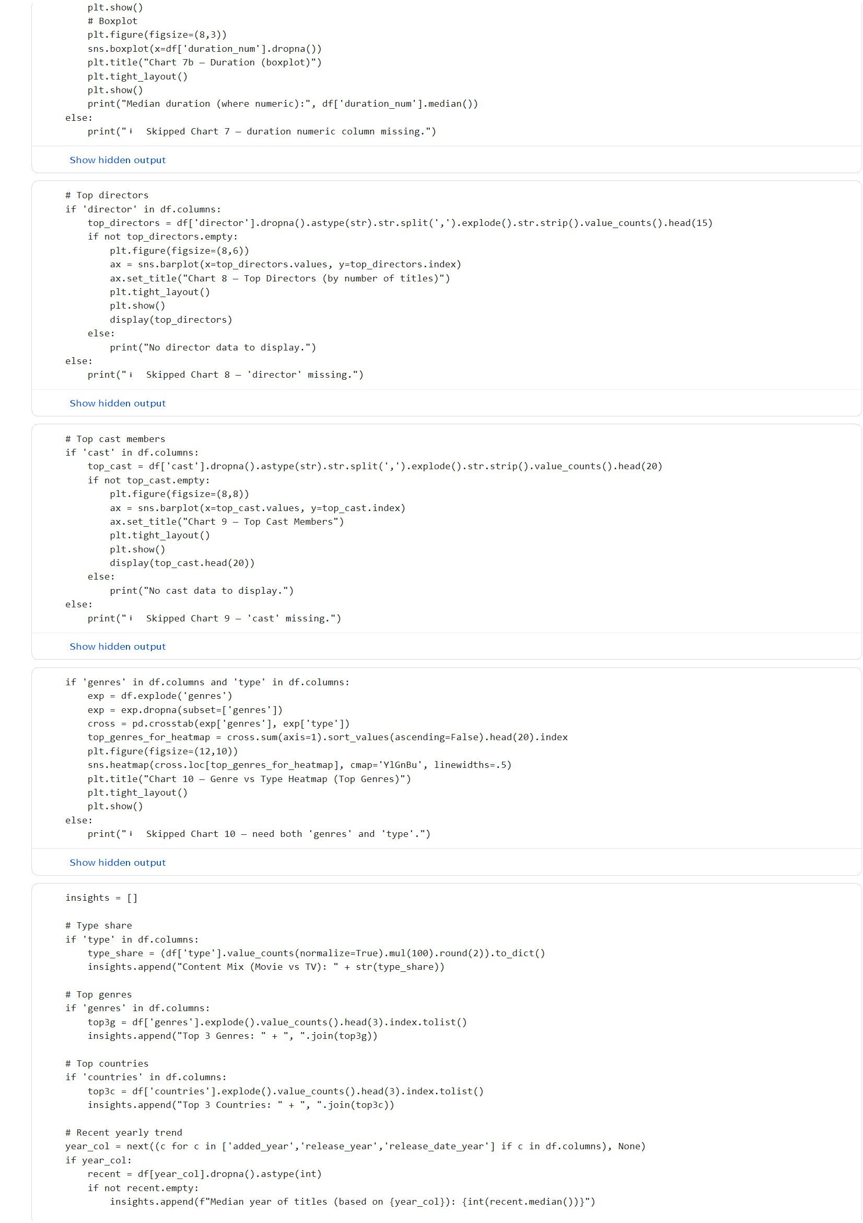
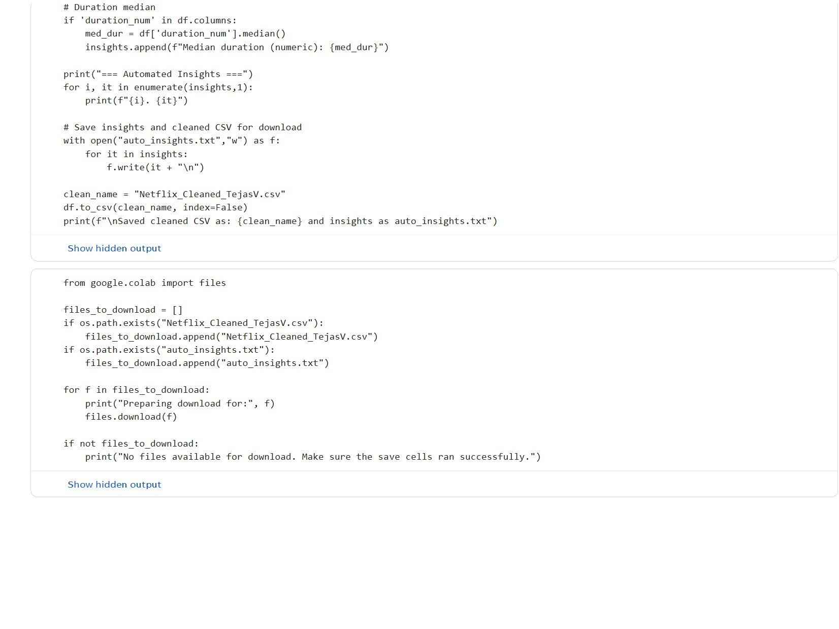
RESULTS2
Add screen shot of graph

Slide 8
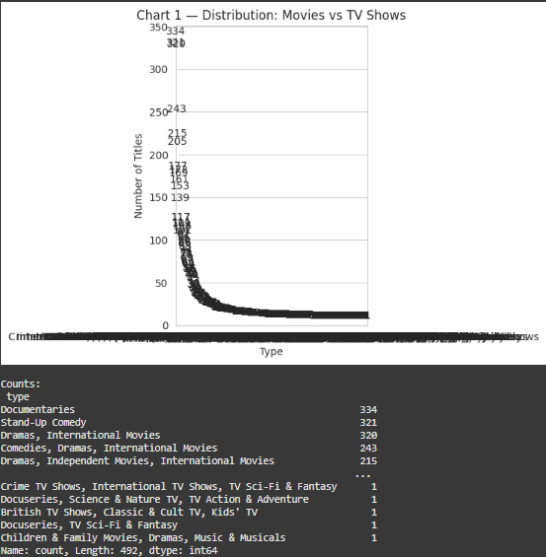
RESULTS3
Paste the screen shot of your code​

Slide 9
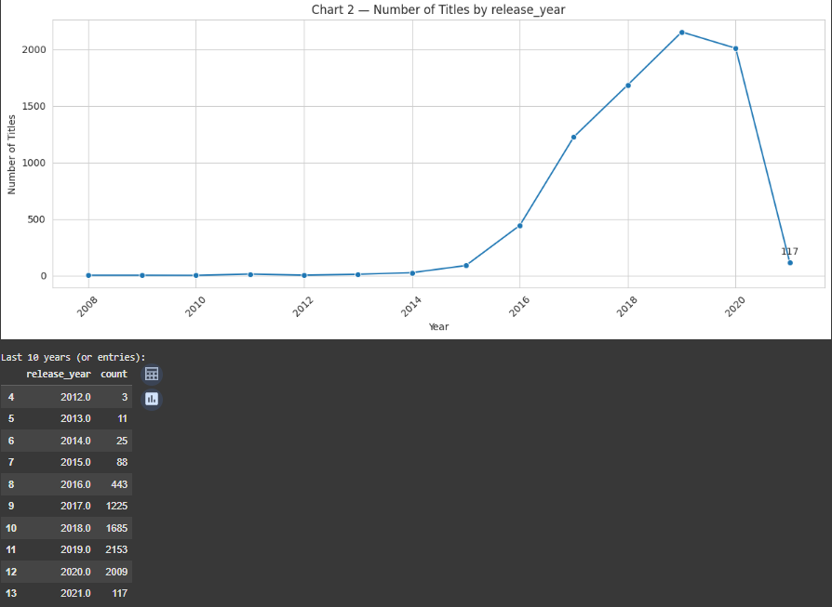
RESULTS4
Paste the screen shot of your code​

Slide 10
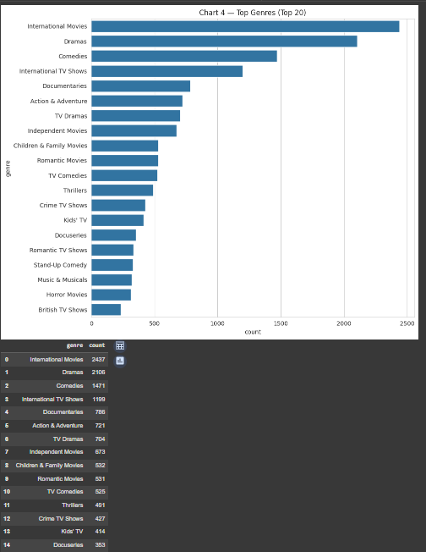
RESULTS5
Paste the screen shot of your code​

Slide 11
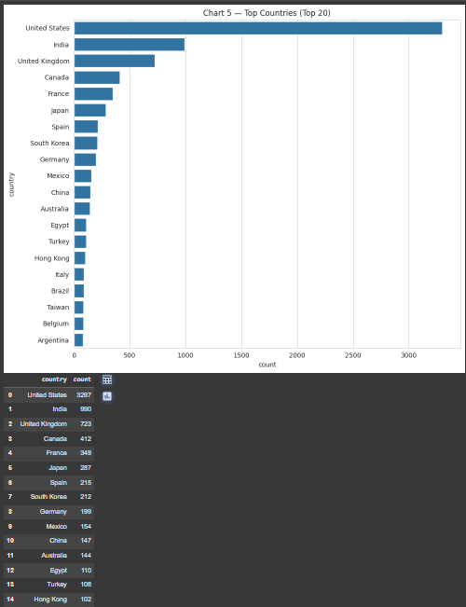
RESULTS6
Paste the screen shot of your code​

Slide 12
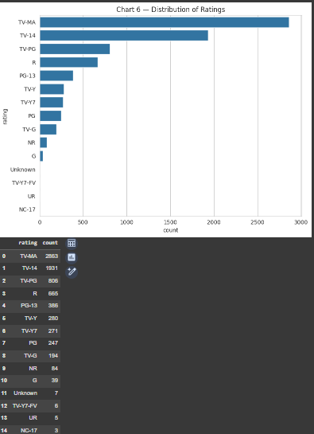
RESULTS7
Paste the screen shot of your code​

Slide 13
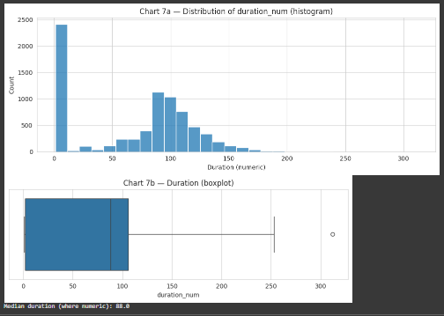
RESULTS8
Paste the screen shot of your code​

Slide 14
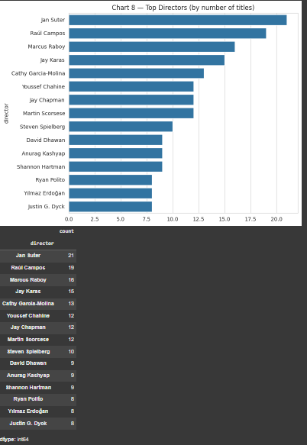
RESULTS9
Paste the screen shot of your code​

Slide 15
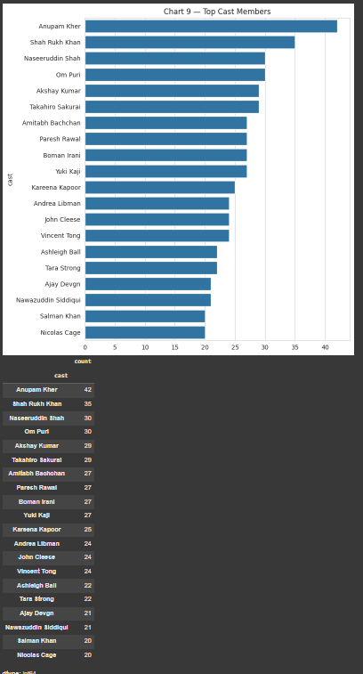
RESULTS10
Paste the screen shot of your code​

Slide 16
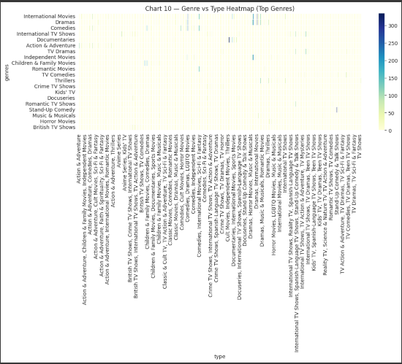
RESULTS11
Paste the screen shot of your code​

Slide 17
GitHub repository
[ https://github.com/Tejkv/VOIS_AICTE_Oct2025_MajorProject_Tejas-V.git ]

Slide 18

Getting started with Basics of Python Certificate
[Paste your Certificate Here]

Slide 19
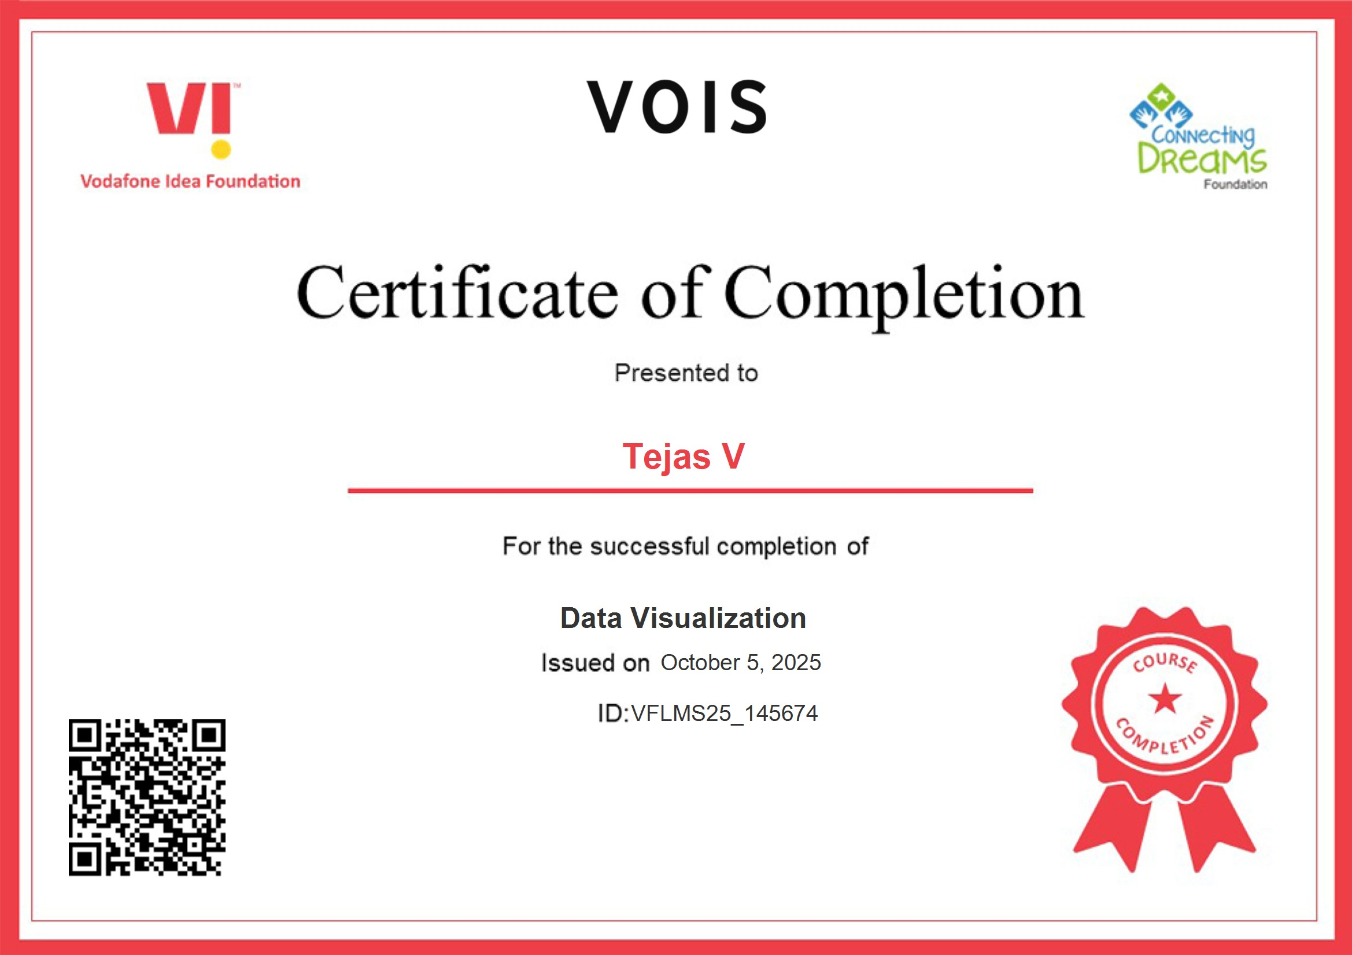
Data Visualization Certificate
[Paste your Certificate Here]

Slide 20
Thank you
.
.

